Slide 1
Lecture - 11
The Role of System Analyst
Topics to be covered:
The analyst /user interface: Behavioral issues, Conflict resolution;
The MIS organization.
Monday, November 30, 2020

Slide 2
Analyst /User Interface
It is important to develop a viable interface between analyst and user
The analyst make a productive relationship with the user
The probability of system failure increases without close analyst/user interface

Slide 3
Behavioral Issues
User Motivation
Analyst/User Differences
Political Factors

Slide 4
Behavioral Issues: User Motivation
Several Models of user behavior attempted to look at motivation for system acceptance
Lucas’s descriptor model identifies
Attitudinal, personal, and situational factor
Use of the system depends on
Positive attitude towards system features
Decision making style of the user

Slide 5
Behavioral Issues: Analyst/User Differences
Differences exist in
Education, experience, and language
The analyst’s annoyed with the user’s ignorance about the terminology like chip and CRT
The user’s annoyed with analyst’s limited understanding of the business

Slide 6
The Places of the Analyst in the MIS Organization
MIS?
“MIS” stands for Management Information Systems.
So, MIS Managers are responsible for managing the information systems of their employer.
They are involved with any task related to installing, upgrading or repairing these information systems.
Their primary concern is with keeping their employer’s information and data safe and secure.

Slide 7
The Places of the Analyst in the MIS Organization
The MIS Organization
The organizing function is the task of grouping and assigning work elements to appropriate areas.
An MIS manager organizes by assigning tasks, dividing works into specific jobs, and defining the relationship among them.

Slide 8
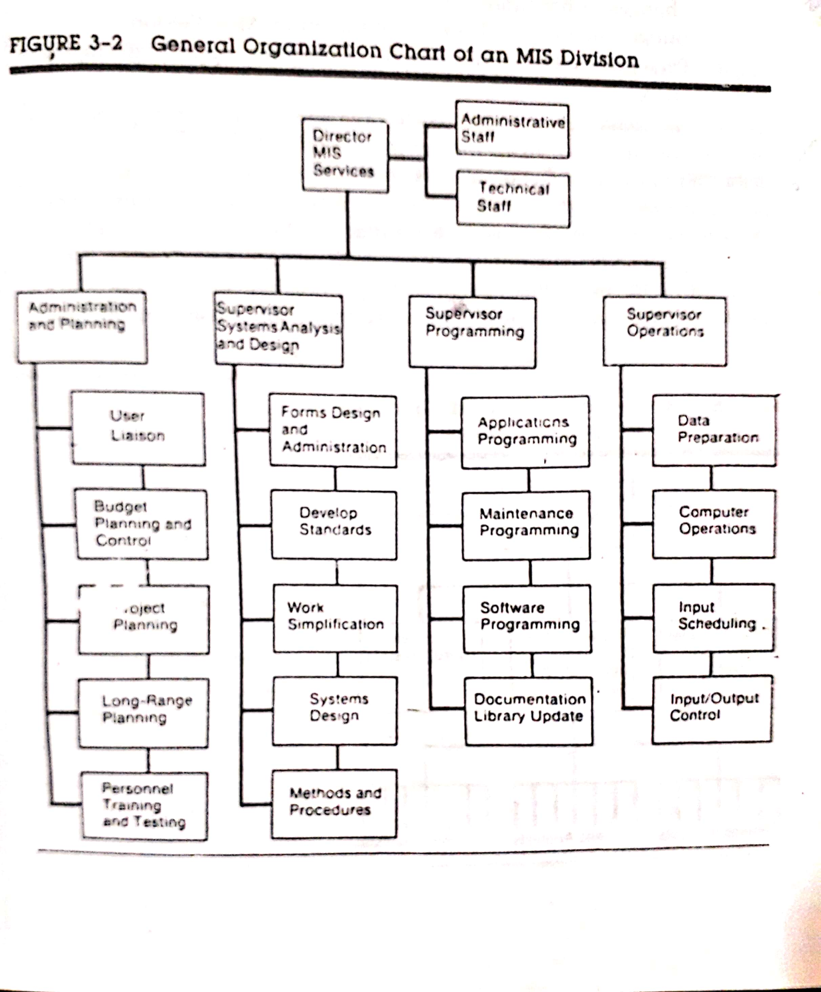
The Places of the Analyst in the MIS Organization: The MIS Organization
The MIS organization structure encompasses supervisory levels, authority relationships, and the general pattern of activities carried out by employees at each level.
Figure shows a general organization structure of an MIS facility.

Slide 9
The Places of the Analyst in the MIS Organization: The MIS Organization
The chain of command extends from manager to subordinate.
There is a direct line of authority from the director of MIS services to each of the supervisors in charge of administration and planning, analysis and design, programming, and operations.
This lines of authority permits a supervisor to exercise direct command over subordinates to carry out their tasks.

Slide 10
Primary Functions of an MIS Facility
Administration
System Analysis and Design
Programming
Operations

Slide 11
Primary Functions of an MIS Facility: Administration
Administration is represented by four activities:
User liaison which handles the changing needs of the user and user-systems relationships
Long-range planning, which includes personnel selection, recruitment, application development, and planning for anticipated changes in hardware and software.
Budget planning and control of the entire MIS division.
Personnel administration and training for upgrading employee skills.

Slide 12
Primary Functions of an MIS Facility: System analysis a Design
System analysis and Design may be organized as…..
project-oriented,
pool-oriented, or
functional.

Slide 13
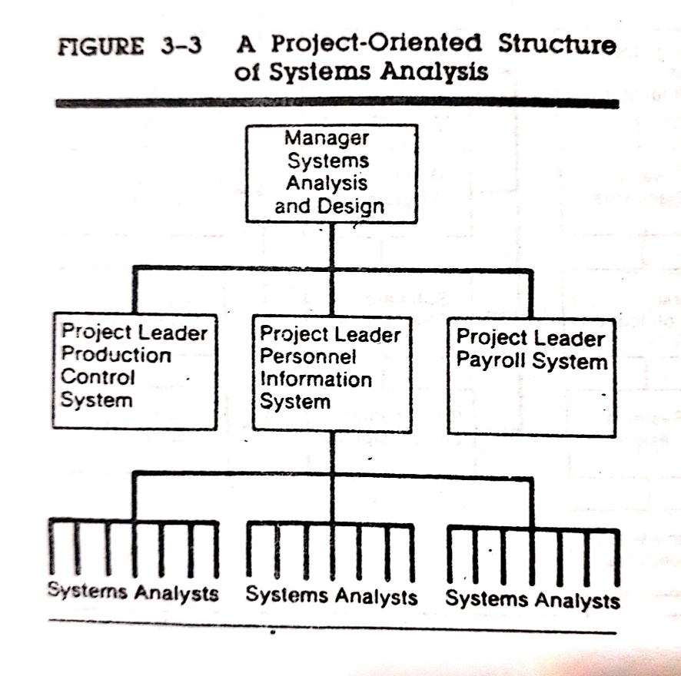
Primary Functions of an MIS Facility: System analysis a Design
In a project-oriented arrangement, a team of analyst is formed to work on one project. A shown in Figure…..
Each team has a project leader who reports directly to the system manager.
This arrangement is typical of smaller installations that handle limited projects.

Slide 14
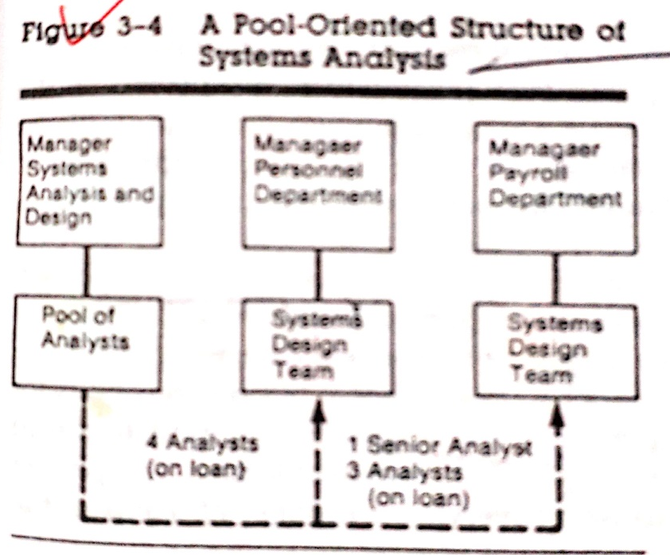
Primary Functions of an MIS Facility: System analysis a d Design
In a pool-oriented arrangement, analysts work on any system assignment within the firm.
Once the job is completed, they return to the pool for another assignment. A shown in Figure…..
A system team is on loan to report directly to the manager of the operating department where the application deign is requested.
This arrangement gives the department some control over its own application.
The outcome is greater user participation and support in system development.

Slide 15
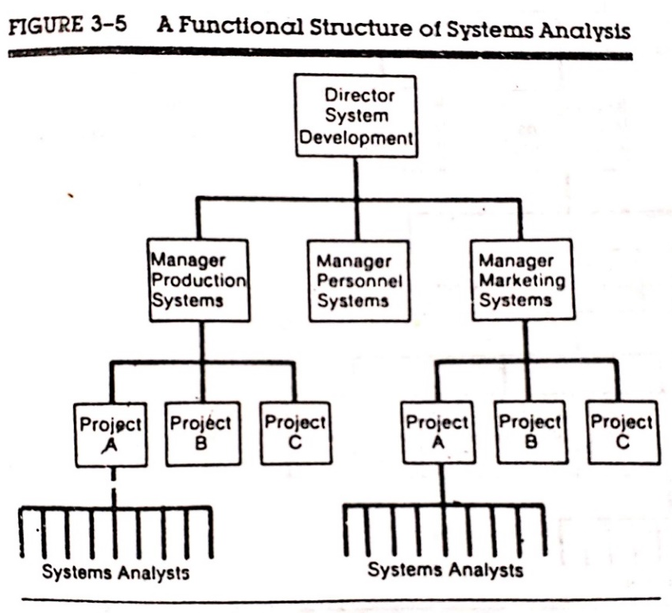
Primary Functions of an MIS Facility: System analysis a Design
The Functional structure of analysis assigns a group of analyst to serve a specific system.
For example, there may be a personnel systems team, a production systems team, and a marketing systems team.
Each team has a manager who reports directly to the director of system development (see Figure).
This arrangement is suitable for a
large computer facility.

Slide 16
Primary Functions of an MIS Facility: Programming
Programming is structured around three areas:
Application,
Software, and
Maintenance.
In many application, programmers are placed on the same project team with analysis.
Software programmers are responsible for modifying compilers and software packages used by existing applications.
Maintenance programmers handle all changes required to keep a system operating.

Slide 17
Primary Functions of an MIS Facility: Programming
Programming is organized on a pool or team basis.
The pool approach clusters programmers into a pool that reports to a supervisor. Each programmers is assigned a program to prepare through all stages.
In the team approach, each programmer is assigned to a team that has responsibility for a specific project.

Slide 18
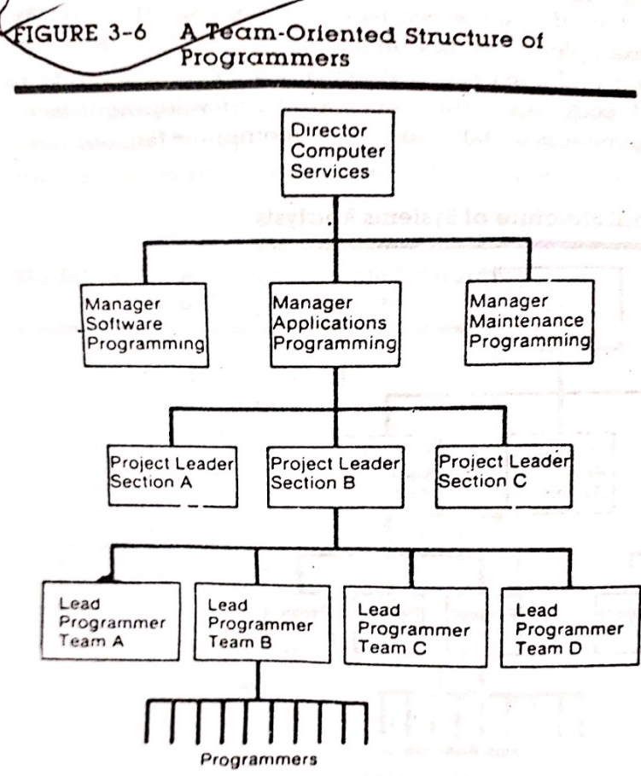
Primary Functions of an MIS Facility: Programming
As shown in Figure, programmers reports to a lead programmers (team leader), who reports to the projects leader.
The projects leader is usually a section head who supervises a number of teams in the section and reports to the manager of the programming area.

Slide 19
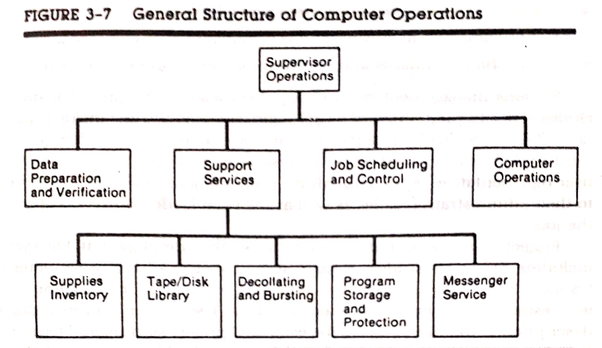
Primary Functions of an MIS Facility: Operation
Operation handles job scheduling and supportive services such as coordinated with systems and design and programming under a master plan.

Slide 20
Customers – Users and Management
What is a user?
A user is a person, or group of persons, for whom the systems analyst builds and maintains business information systems and computer applications.
There are at least two specific user/customer groups: system users and system owners.
System users are those individuals who either have direct contact with an information system or application or they use information generated by a system.
System owners provide sponsorship of information systems and computer applications. In other words, they pay to have the systems and applications developed and maintained.

Slide 21
Customers – Users and Management
A manager can also be one of the end users of a system.
Two types of system users:
Traditionally, most system users were internal users, that is employees of the business for which a system or application is designed.
Today’s user community includes external users as businesses seek to make their information systems and applications interoperate with other businesses and the consumer.

Slide 22
Customers – Users and Management
The Roles of Management and Users in Systems Problem Solving
Planning
Management must sponsor and fund all projects.
Users must define the domain and boundaries of the problem.
Analysis
As subject matter experts, management and users must analyze the problem domain for causes, effects, and opportunities; as well as communicate the requirements to be fulfilled by any successful solution, regardless of technology chosen.
Design
Users must react to high-level solution designs and participate in the solution’s design.

Slide 23
Customers – Users and Management
The Roles of Management and Users in Systems Problem Solving
The roles of management and users in:
Implementation
Users participate in system construction and testing. They are the recipients of training necessary to enable the full user community to work with the solution.
Support
Users and management should routinely evaluate the working solution and suggest improvements.

